Slide 1

Disney Movie Analysis in Python
Group 1: Aaron Ledbetter, Xavier Owens, Blake Best, Jose Melendez

Slide 2
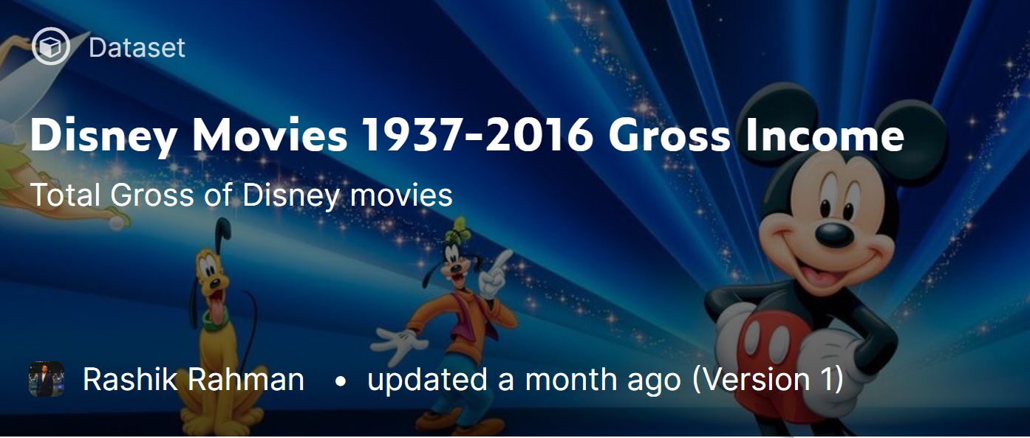
Data collection
We collected our data from Kaggle. The data comes in as a 5 columned table describing movies that disney has made.
The data only encompasses the years from 1937 to 2016. Including total gross income of the movie, and inflation adjusted total income.

Slide 3

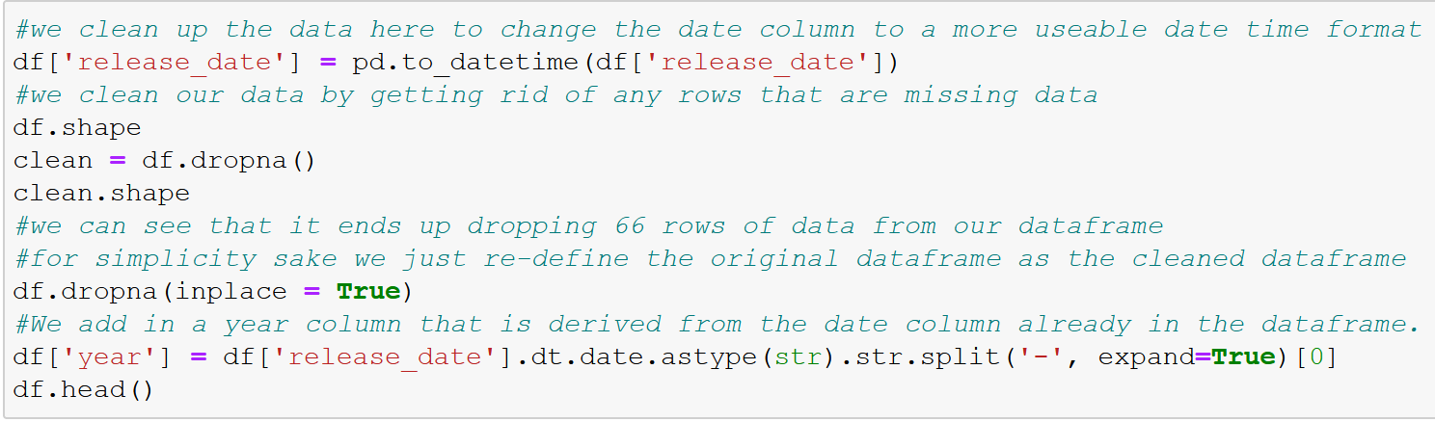
Data Cleaning and Description

Slide 4

Three questions
Since 1936 what genre of movies does Disney most produce?
What genres are most profitable on average?
Is movie year correlated with gross income?

Slide 5
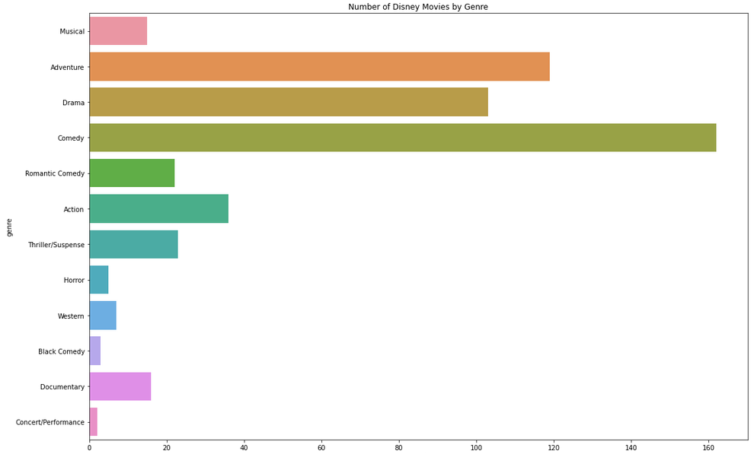
Since 1936 what genre of movies does Disney most produce?
Results: After grouping and each movie title by rating and charting on a bar chart.
Top 3 Disney movies:
Comedy
Adventure
Drama

Slide 6
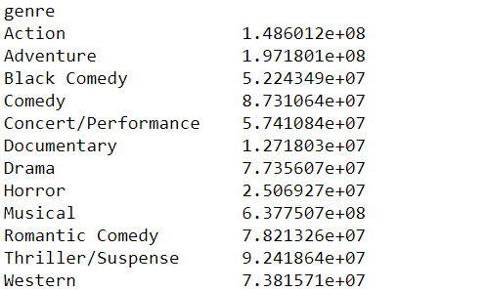
What genres are most profitable on average?
Results: After grouping and each movie title by genre and calculating the mean of each group. We can see that not all genres perform well with Disney’s audience and many of their top performing movies are children movies.
Top 3 Disney movies:
Thriller / Suspense $92,418,640
Comedy $87,310,640
Romantic Comedy $78,213,260

Slide 7

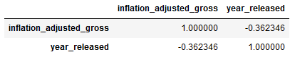
Are years Released and Inflation Adjusted gross Income correlated?
Results: After slicing and doing a correlation analysis we get a correlation value of -.36
This value tells us clearly that year and gross income are not correlated.

Slide 8
Visualizations

Slide 9
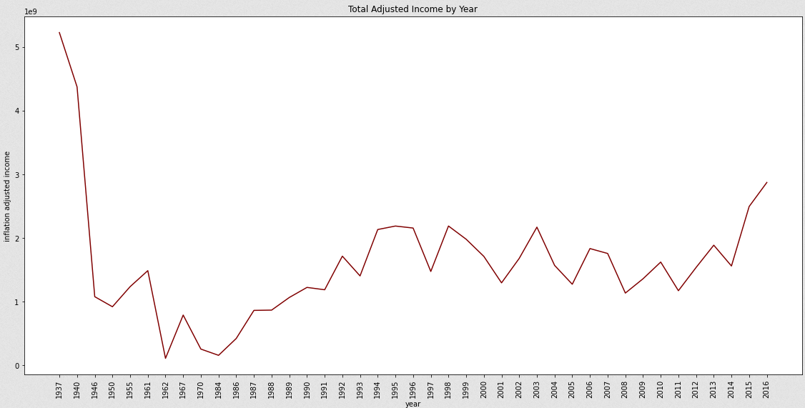
Total adjusted Income by Year

Slide 10
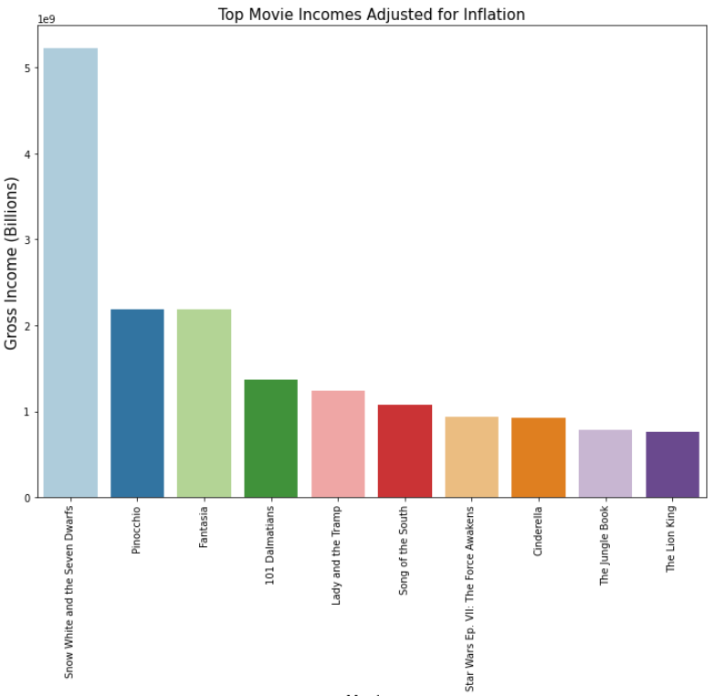
Top grossing Movies

Slide 11

Business insights
Comedy movies are by far the most common and profitable genre Disney has created, although Adventure and Drama are a very close second and third.
Disney’s focus on quality movies proves that movie companies do not need to continuously pump out movies to be successful. Disney is able to make a profit with only one movie every few years in many cases.

